Slide 1


Trojan-horse attacks on practical continuous-variable quantum key distribution systems
Imran Khan, Nitin Jain, Birgit Stiller, Paul Jouguet, Sébastien Kunz-Jacques, Eleni Diamanti, Christoph Marquardt and Gerd Leuchs

Slide 2
introduction

Slide 3

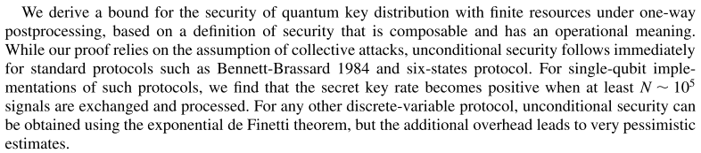
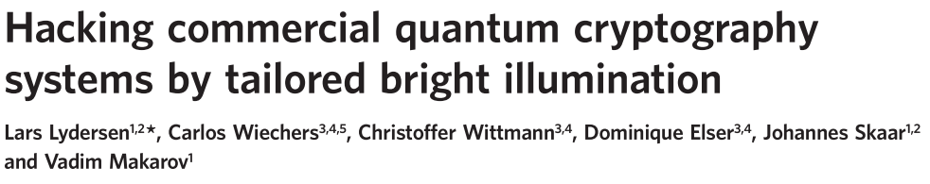
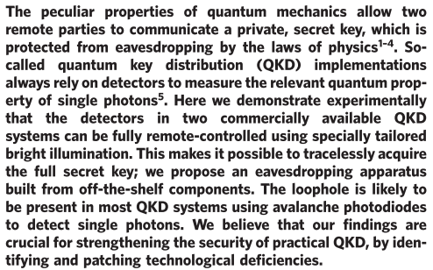
Quantum Hacking
security proofs for quantum key distribution
Theoretical model
Some assumptions in security proof may be incorrect or insufficient
Implementation
Technological deficiencies/imperfections
exploit discrepancy of
theoretical model
vs
practical implementation
→ Eve obtains a portion of the secret key while staying concealed
quantum hacking
helps
strengthen practical QKD

Slide 4
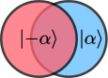
Trojan-horse attack principle
Alice
Source of back-reflection
Quantum
channel
Bob
Laser
modulator
Receiver
Prepares alphabet of non-orthogonal quantum states and sends them to Bob
(e.g. two state alphabet)
Eve
Receiver
Laser
When to send in the pulse/expect the reflection to return? [Timing]
What is the no. of photons per pulse (n) needed? [Brightness/Color]
Which property of the back-reflection to measure? [Tomography]
How to avoid being discovered by Bob/Alice? [Monitors/QBER]
D.S. Bethune and W.P. Risk, IEEE J. Quant. Elec. 36, 3 (2000)
A. Vakhitov et al., J. Mod. Opt. 48, 2023 (2001)
N. Gisin et al., Phys. Rev. A. 73, 022320 (2006)
N. Jain et al., arXiv: 1406.5813, submitted to NJP (2014)

Slide 5
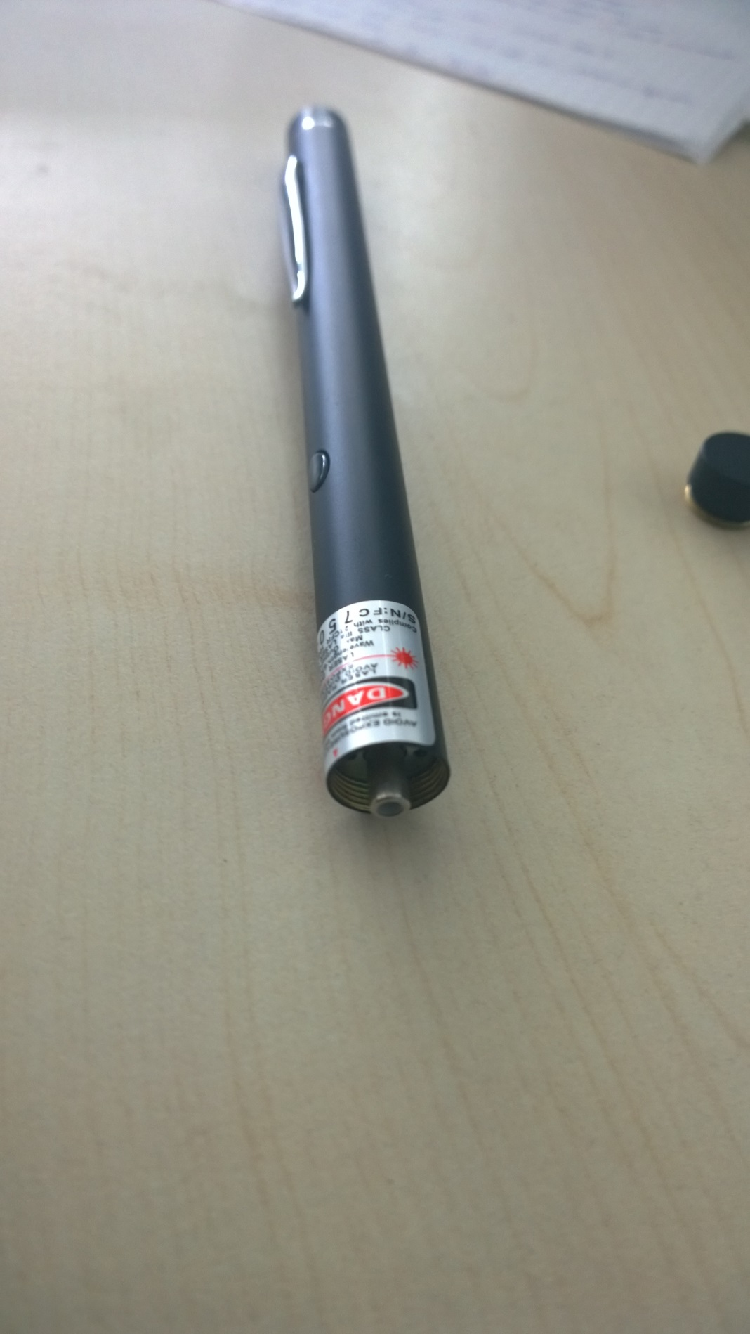
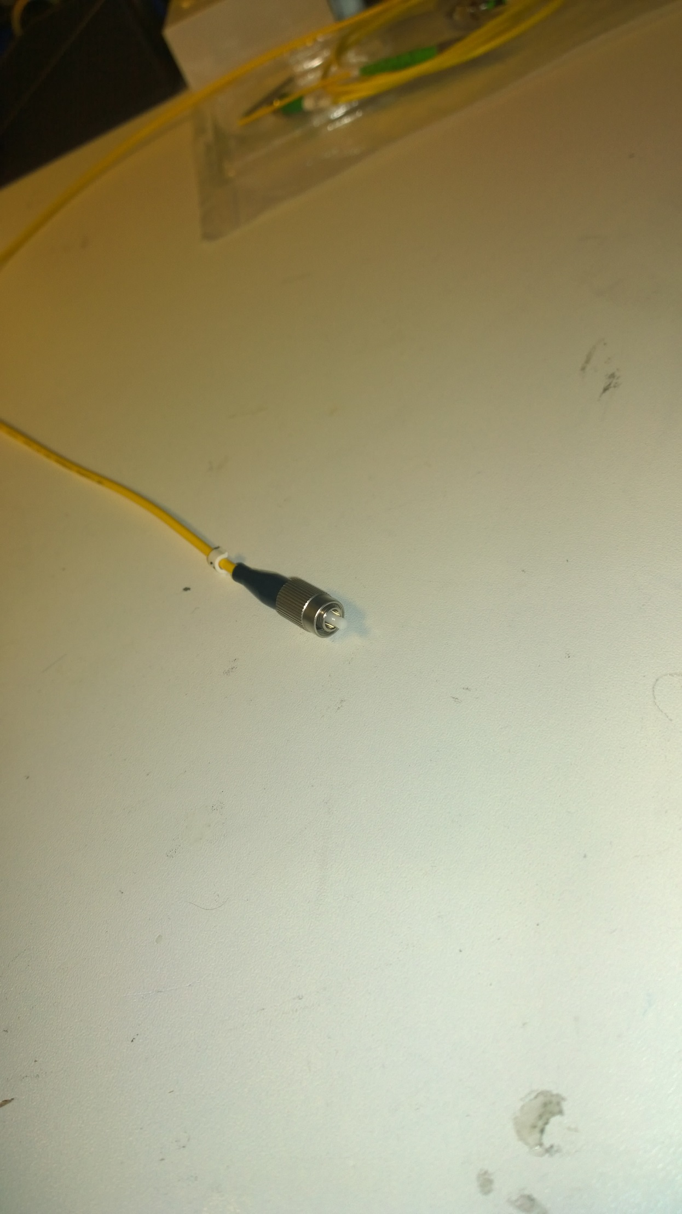
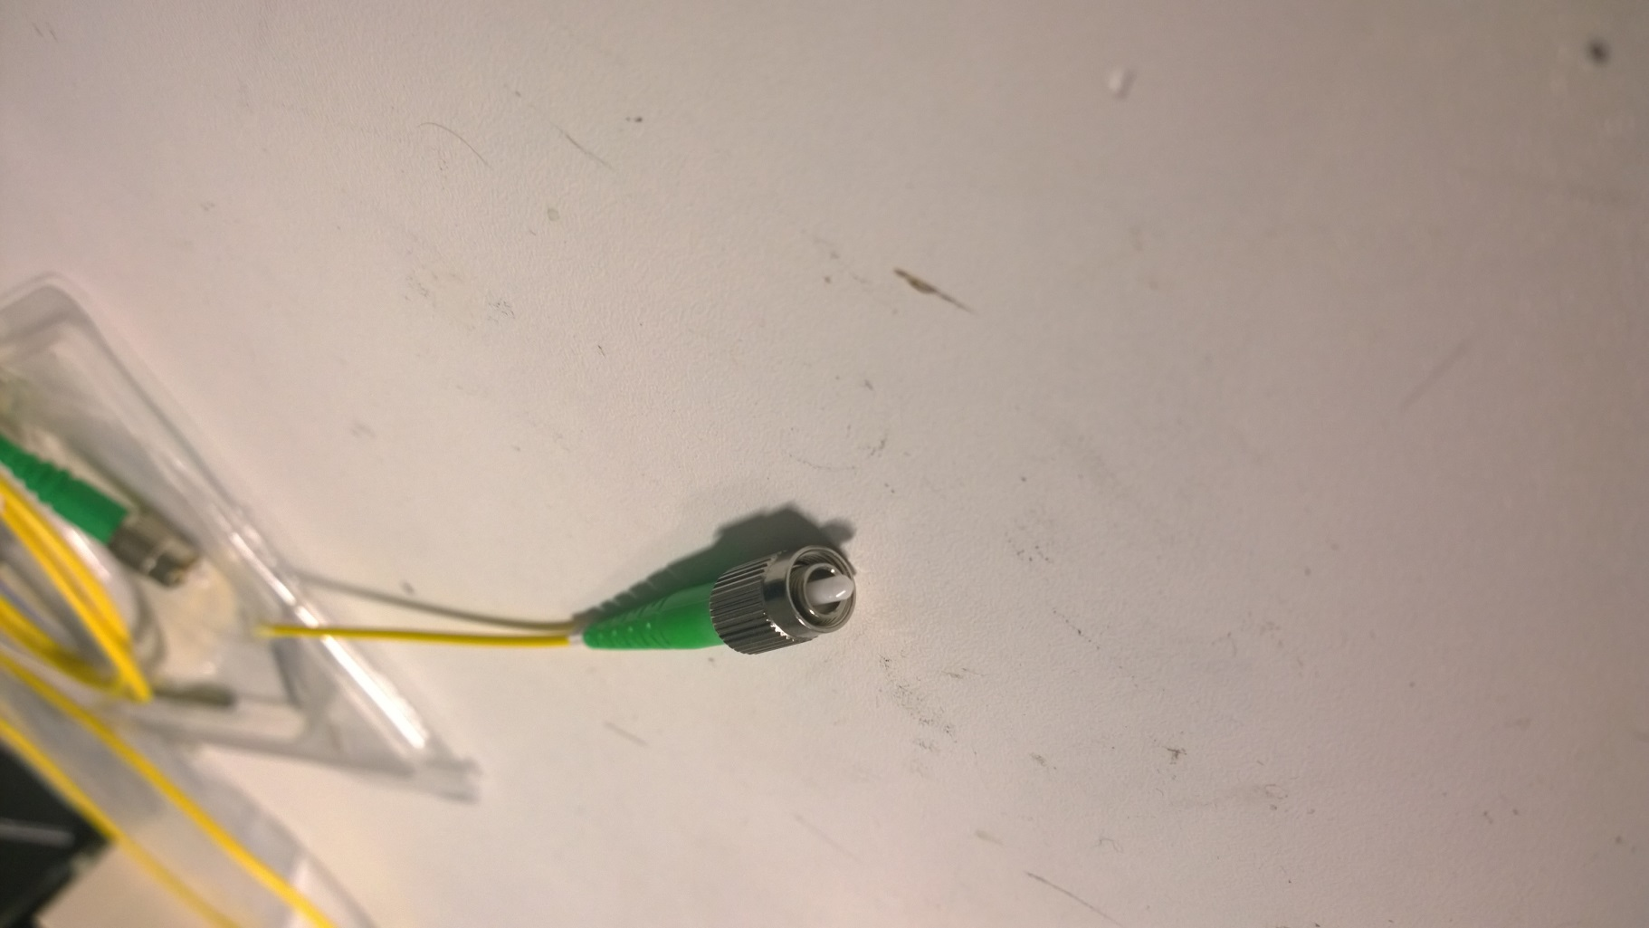
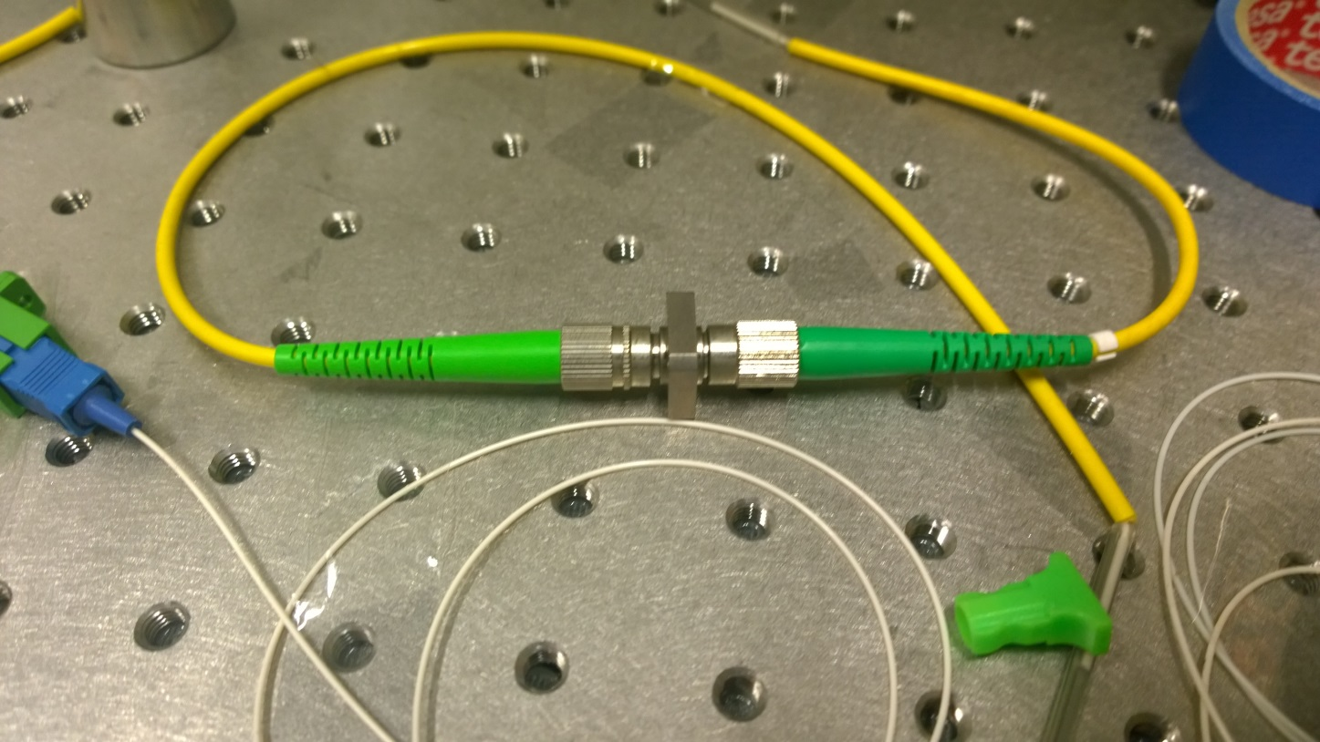
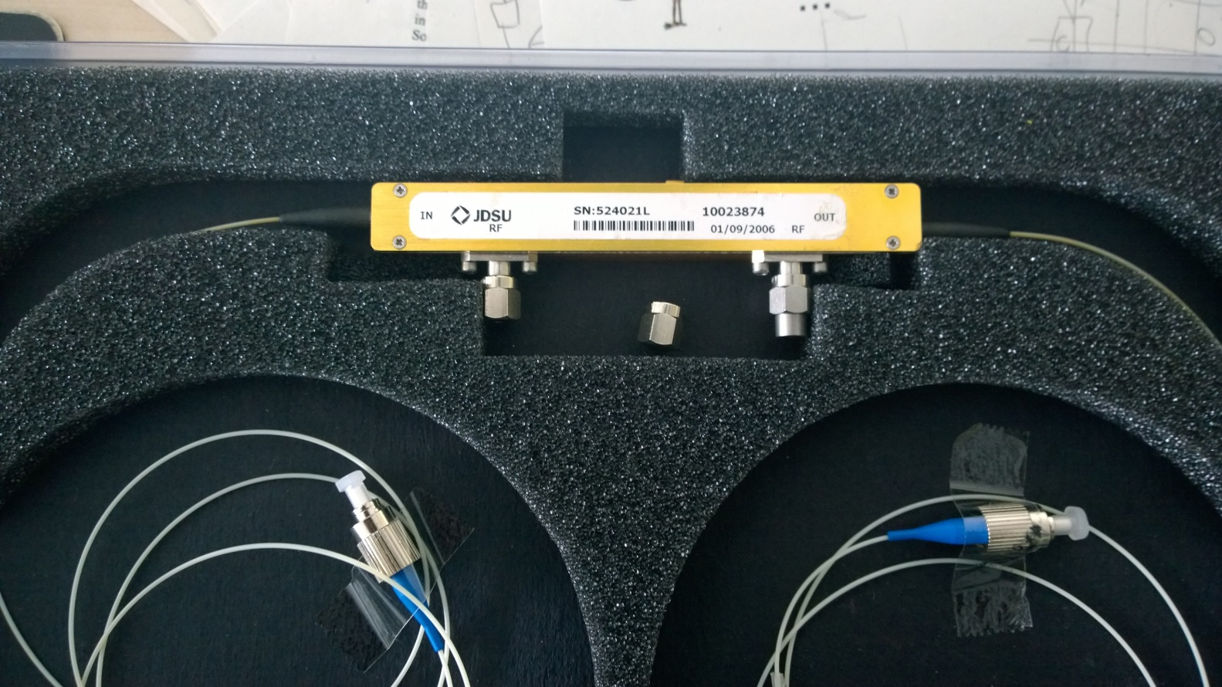
Sources of reflections
flat
angled
Open FC/PC connector
Reflectance: -14 dB
Open FC/APC connector
Reflectance: -45 dB
Laser surface
Reflectance: -60 dB
Closed FC/APC connector
Reflectance: -60 dB
Electro-optic modulator
Reflectance: -45 dB

Slide 6
Eve vs Alice and Bob
Eve‘s task: obtain a portion of the secret key while staying concealed
What plays against Eve?
Detection statistics
The deviation of observed detection rate from the expected value in Bob in state measurement was within tolerable limits.
QBER
The quantum bit error rate (QBER) estimated during the error correction step did not cross the abort threshold of the device.
Hardware countermeasures
Isolators
Optical fuses
Wavelength filters
Watchdog detectors
QBER < threshold
N. Jain et al., arXiv: 1408.0492, submitted to JSTQE (2014)

Slide 7
experimental setups and OTDR measurements

Slide 8
Output of the systems
binary modulation
LO
LO
Alice
Erlangen
signal
signal
H
V
H
V
Features of both systems
Time-multiplexed
Polarization-multiplexed
Alice prepares local oscillator pulse and sends it over the channel
LO
LO
Alice
SeQureNet
signal
signal
H
V
H
V
Gaussian modulation

Slide 9
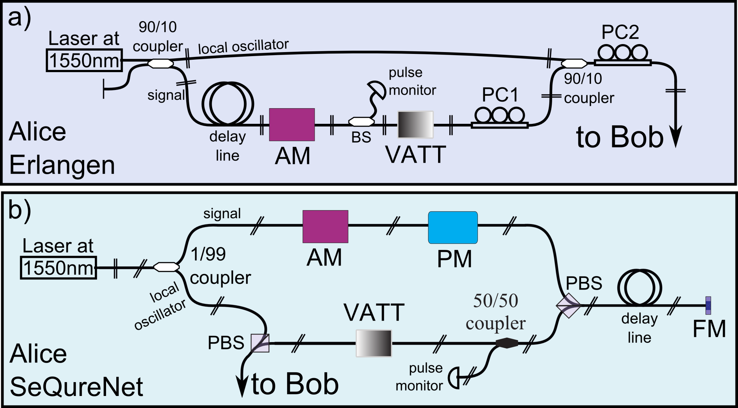
Erlangen and SeQureNet system
C. Bennett, PRL 68, 3121 (1992)
F. Grosshans and P. Grangier, PRL 88, 057902 (2002)
C. Wittmann et al., Opt. Express 18, 4499 (2010)
I. Khan et al., PRA 88, 010302 (2013)

Slide 10
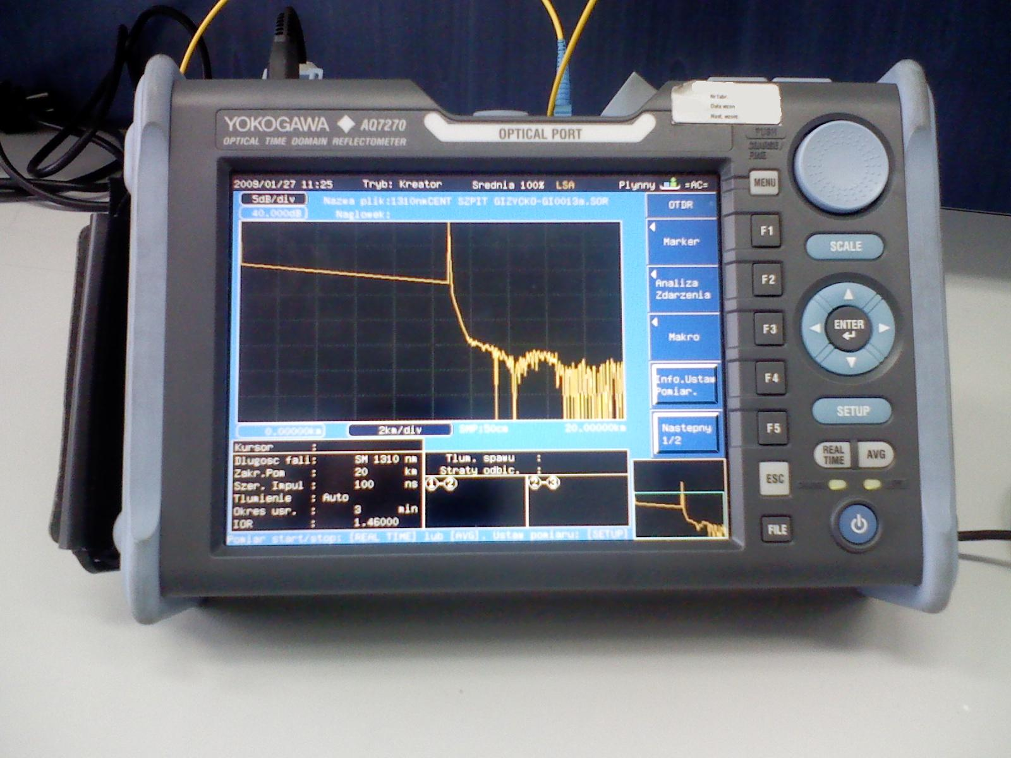
Optical time domain reflectometry
open connector
OTDR
Laser
APD
noise
floor
fiber
fiber scattering
Device under test
image source: http://en.wikipedia.org/wiki/Optical_time-domain_reflectometer

Slide 11
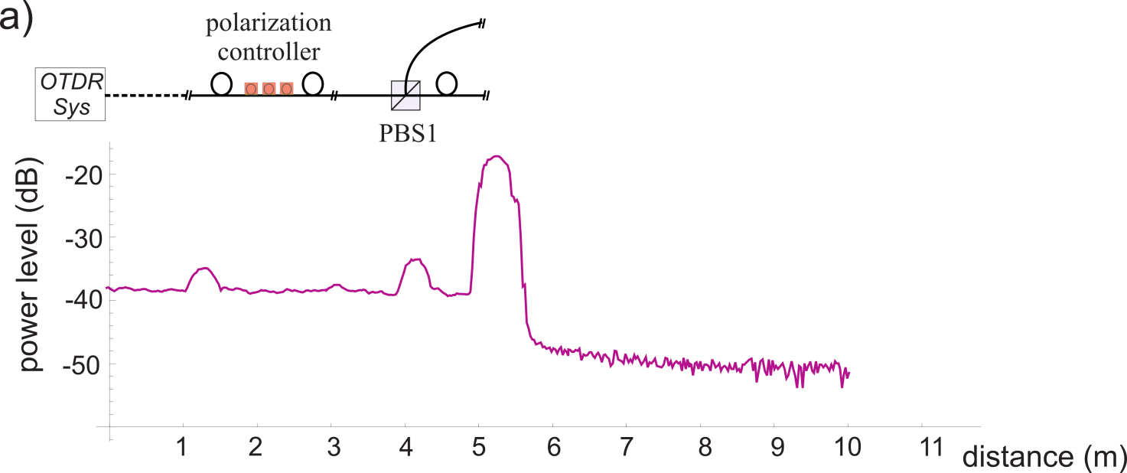
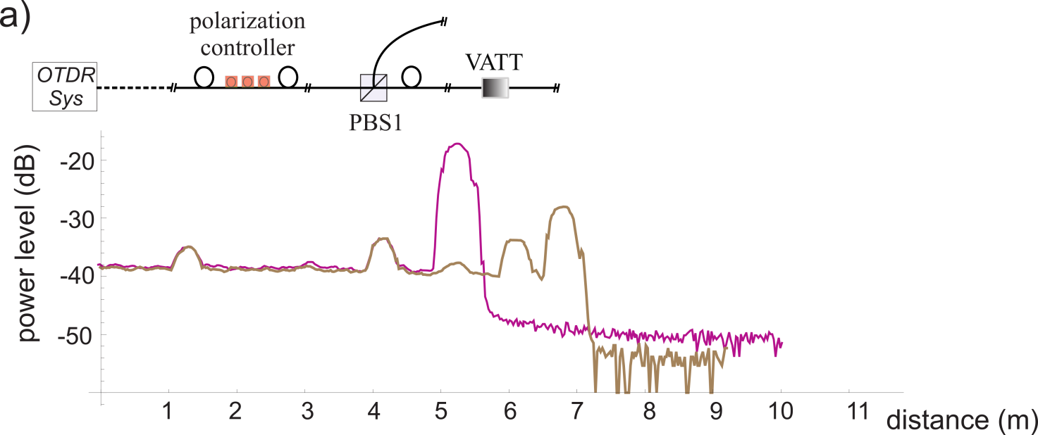
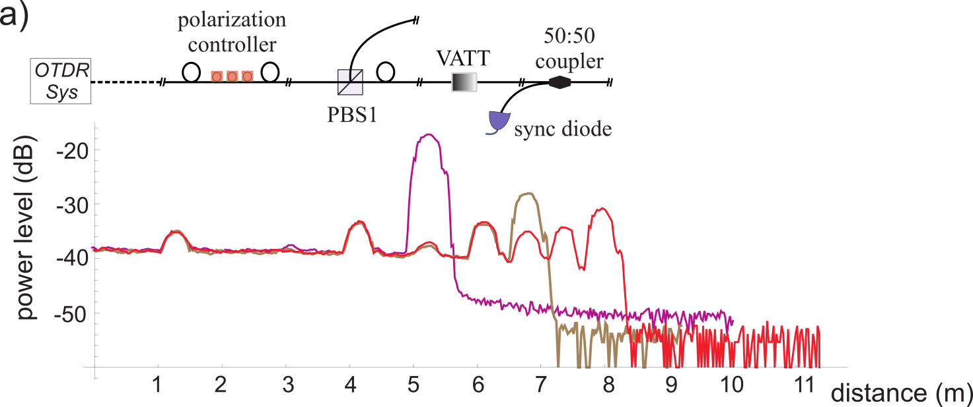
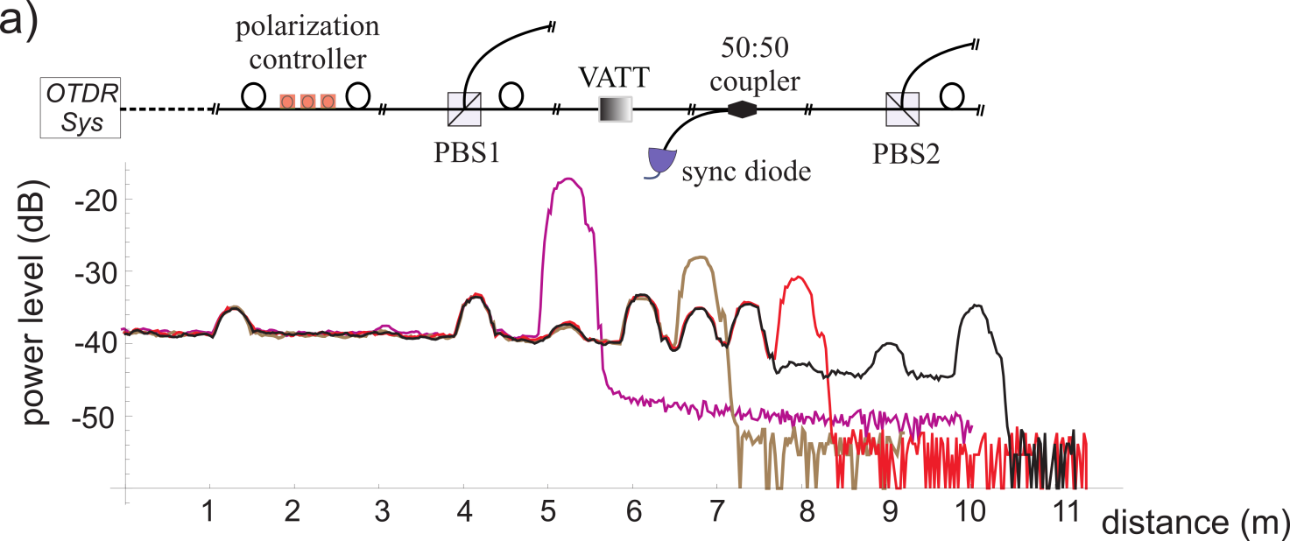
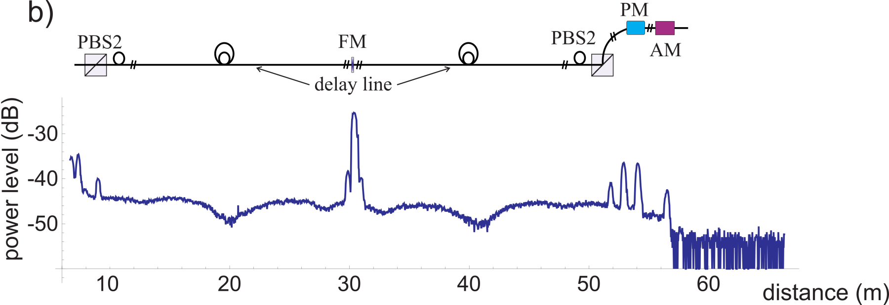
OTDR results (SeQureNet)

Slide 12
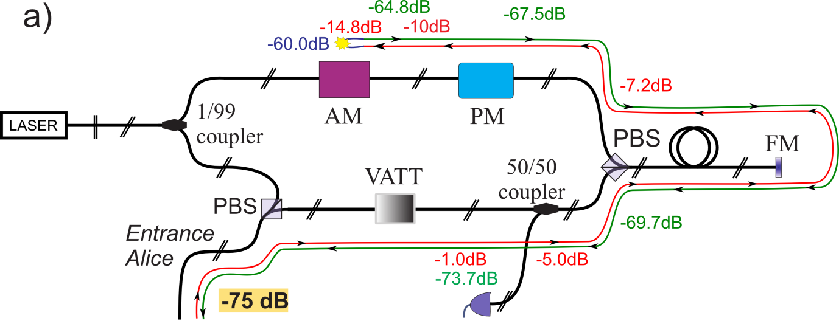
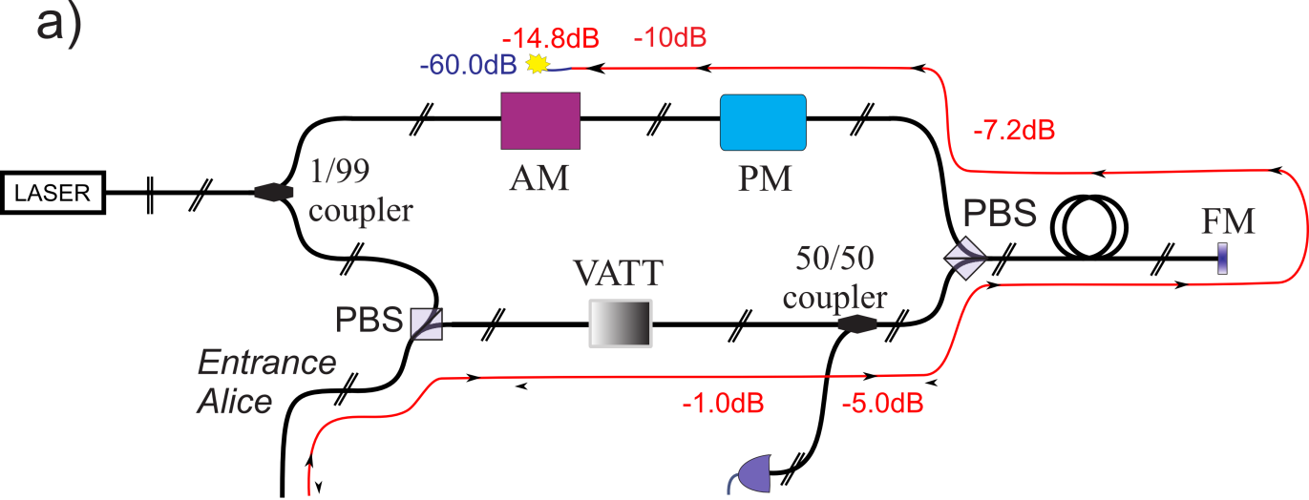
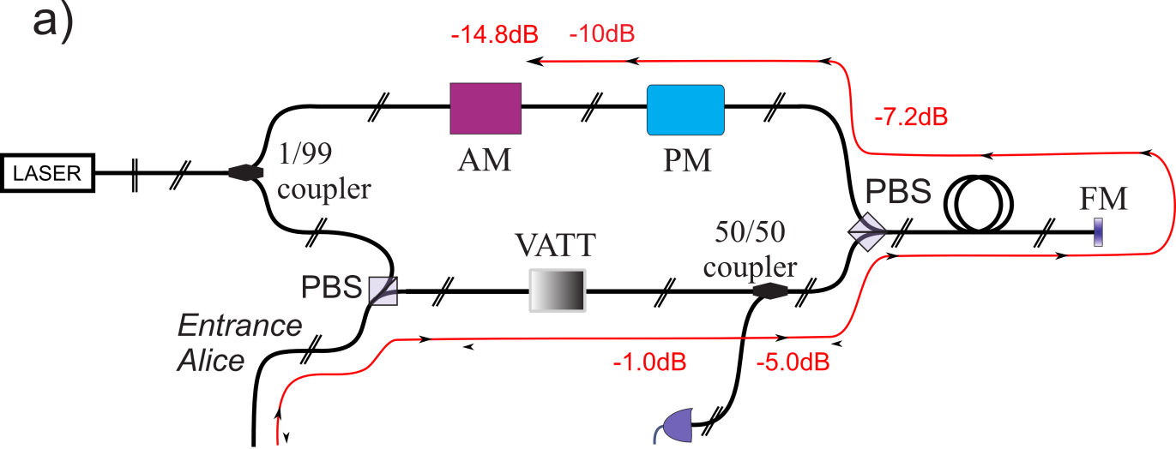
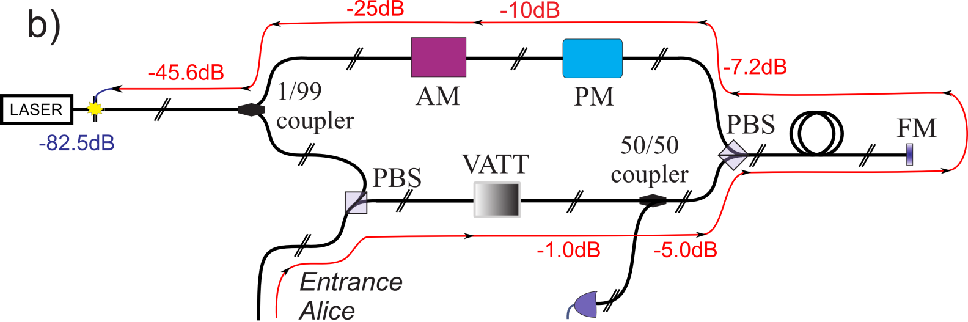
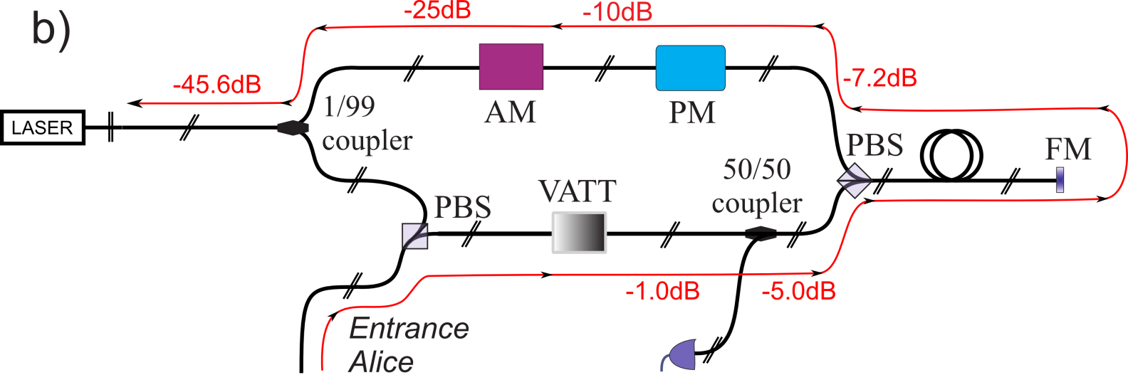
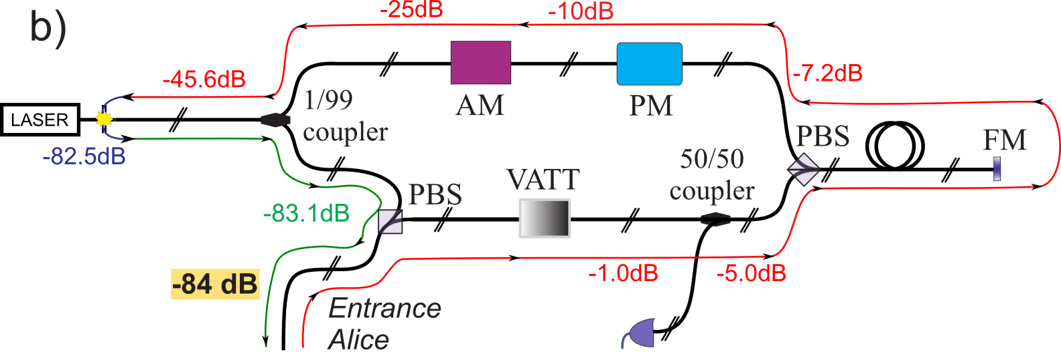
Possible attack paths (SeQureNet)

Slide 13
Hacking SETUP and measurements

Slide 14
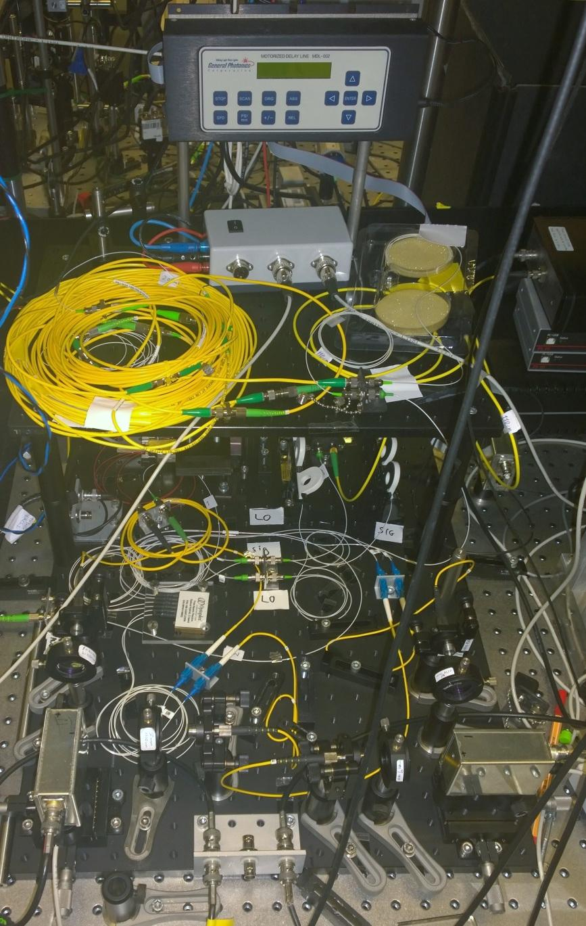
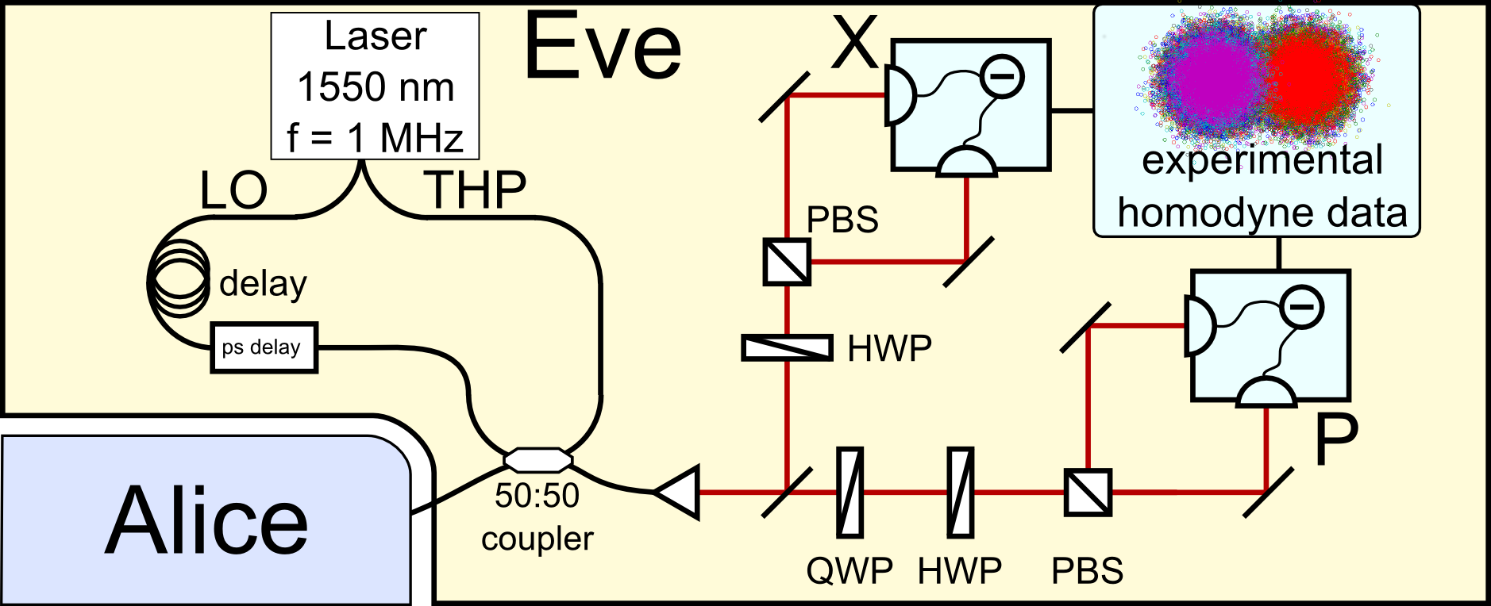
Eve‘s setup
Hacking live demo
Tuesday: poster session
Wednesday: during the breaks

Slide 15
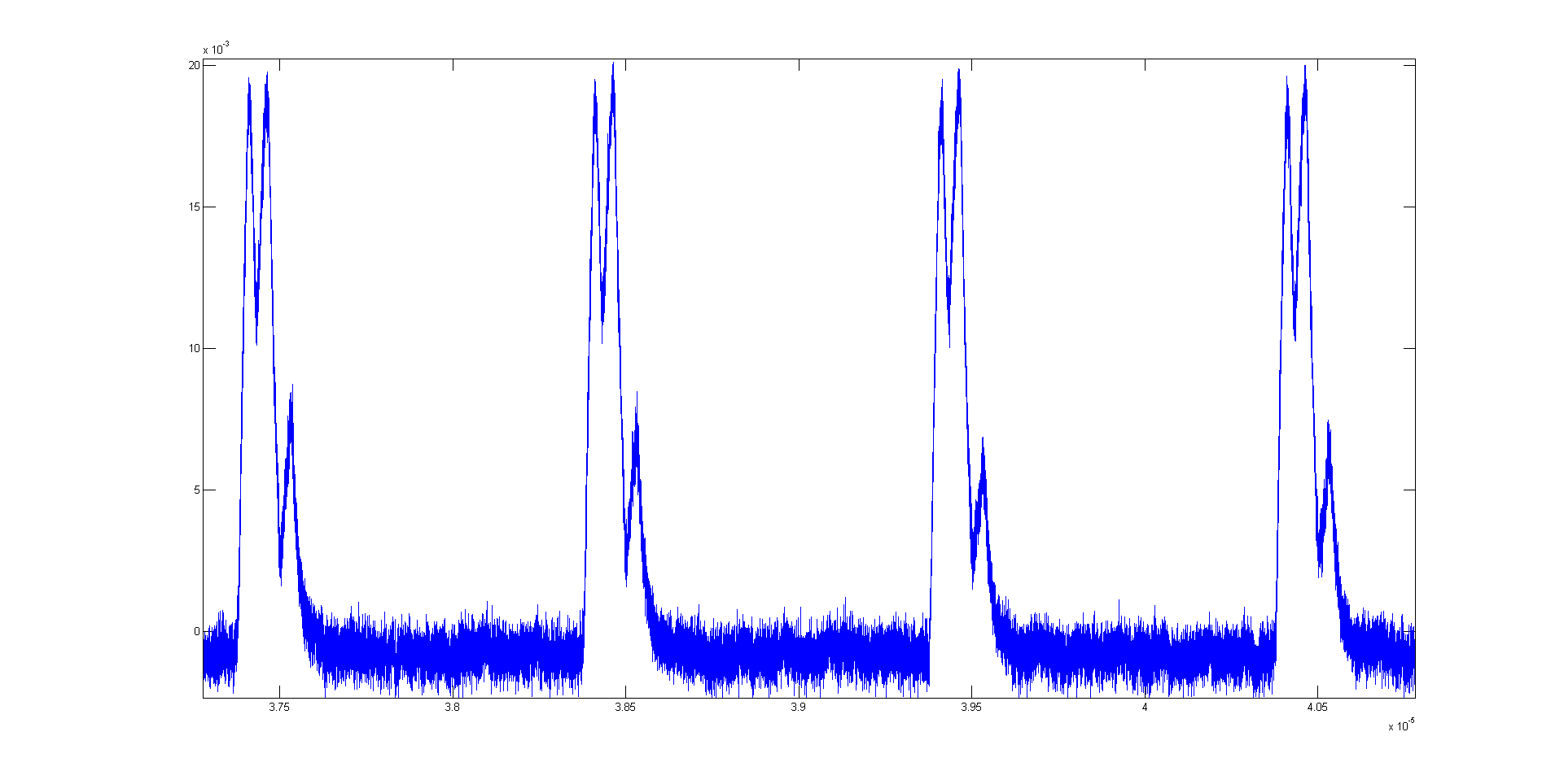
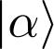
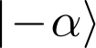
Typical homodyne signal from back-reflections for binary modulation
unwanted
back-reflections
Amplitude
discrimination
threshold
Time

Slide 16
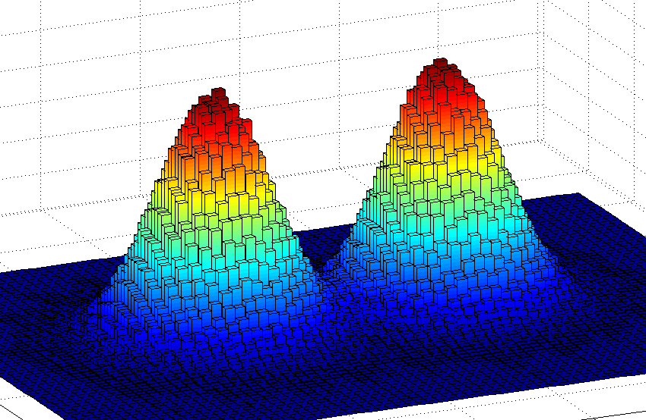
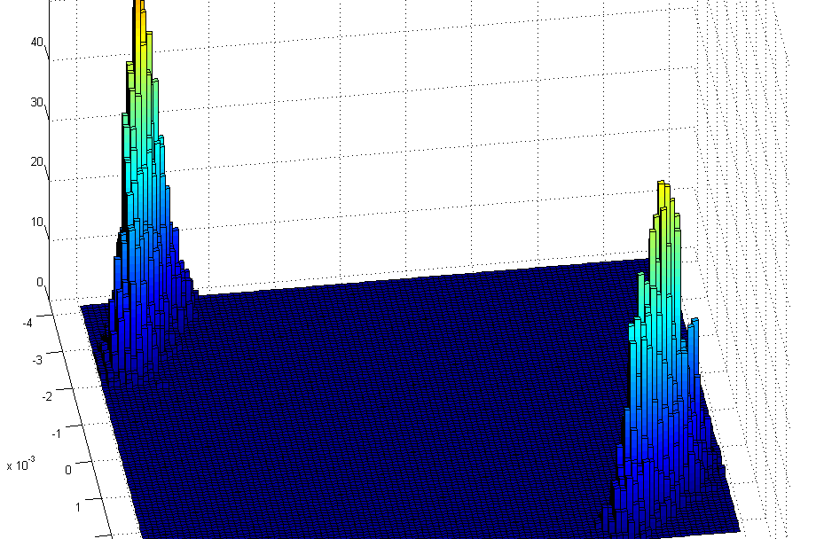
Measurement data: binary modulation
Q-function as measured by Eve for the Erlangen system
Q-function as measured by Eve for the SeQureNet system
1
0
1
0
Discrimination success: >98%
Discrimination success: >99%

Slide 17
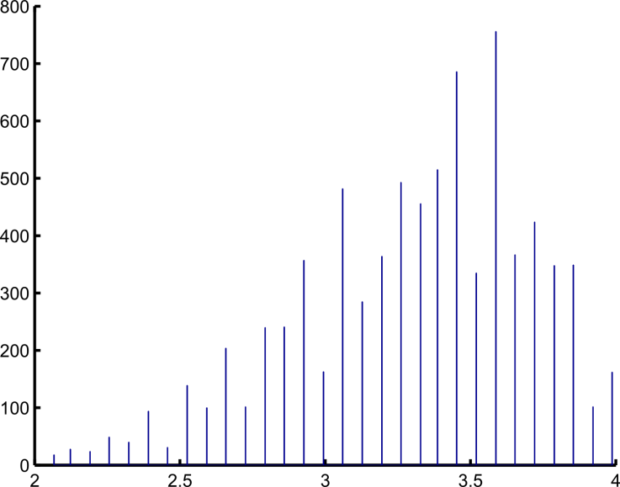
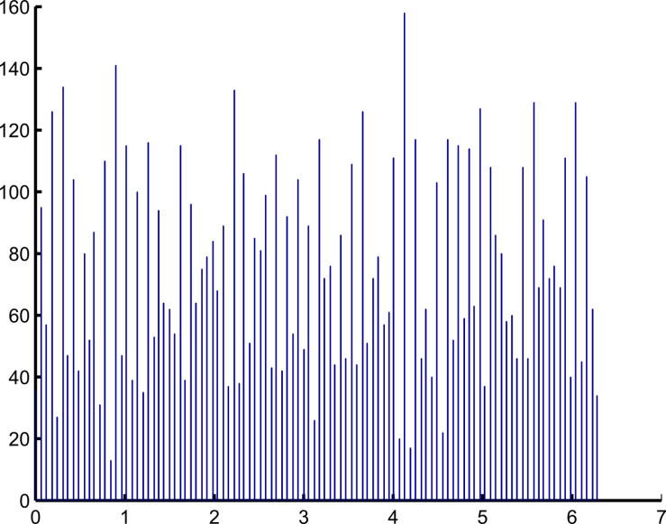
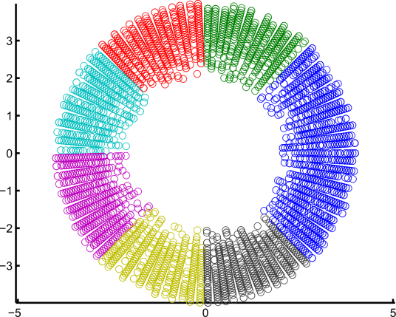
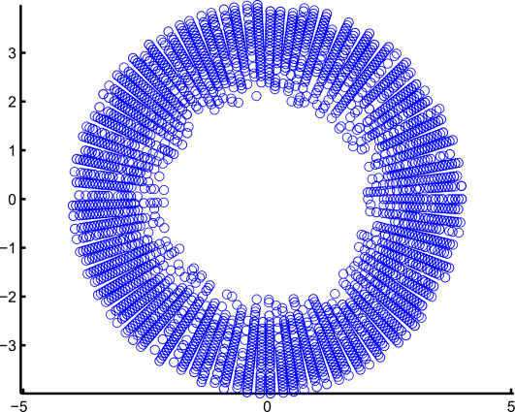
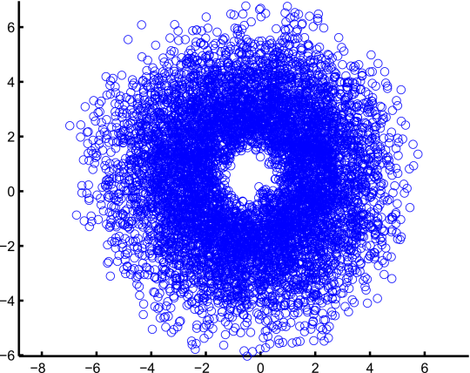
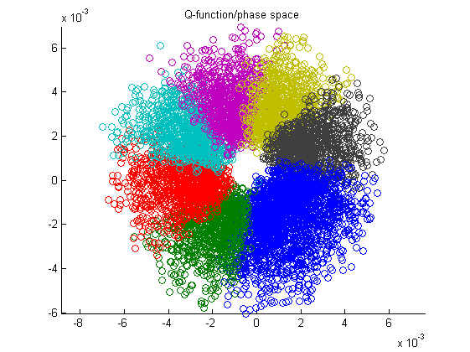
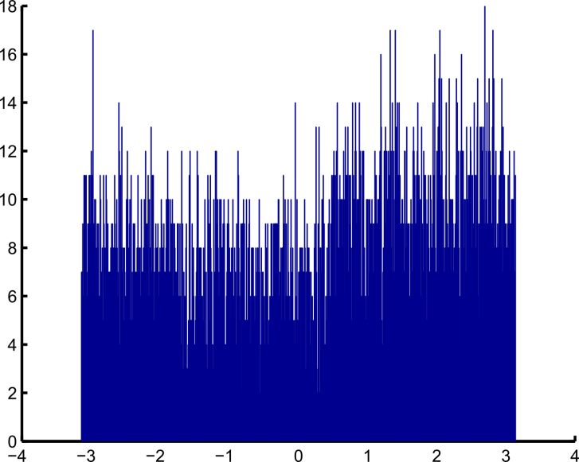
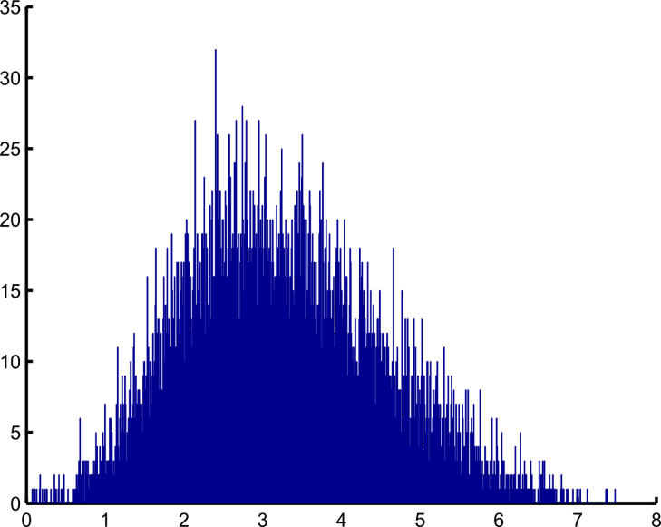
Measurement data: Gaussian modulation
AM voltage
Alice
PM voltage
AM
PM
Voltage phase space
# of occurences
# of occurences
Voltage
Voltage
Gaussian distribution
Uniform distribution
Quadrature amplitude
Quadrature phase space
Quadrature phase
# of occurences
# of occurences
Eve
Homodyne detection
amplitude quadrature [a.u.]
phase quadrature [a.u.]

Slide 18
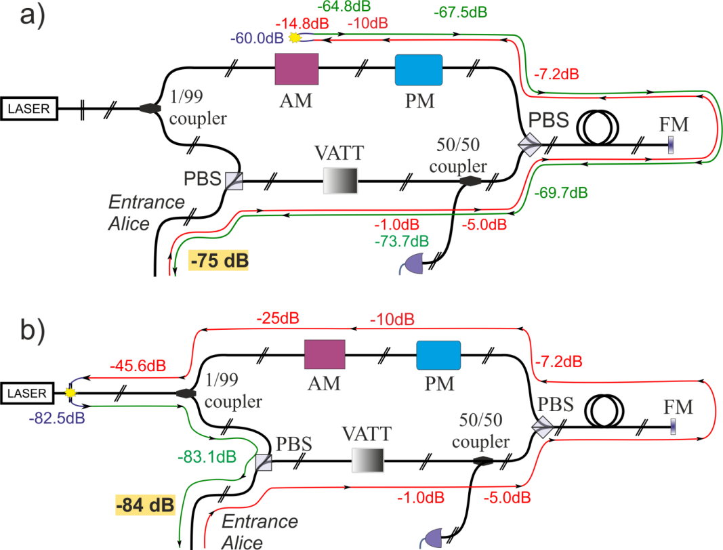
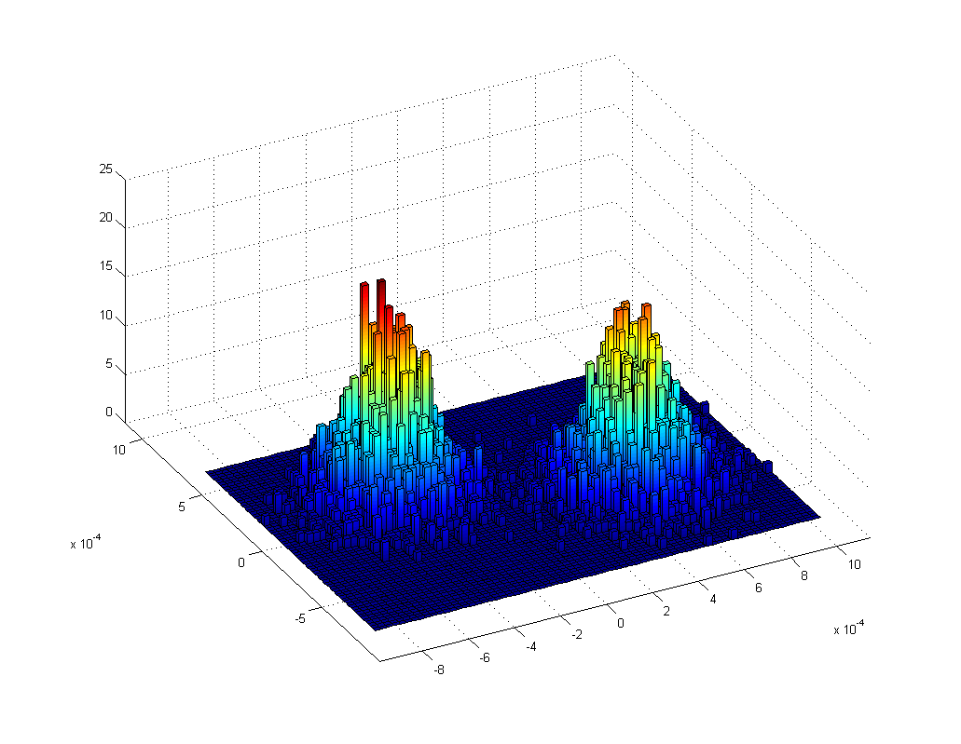
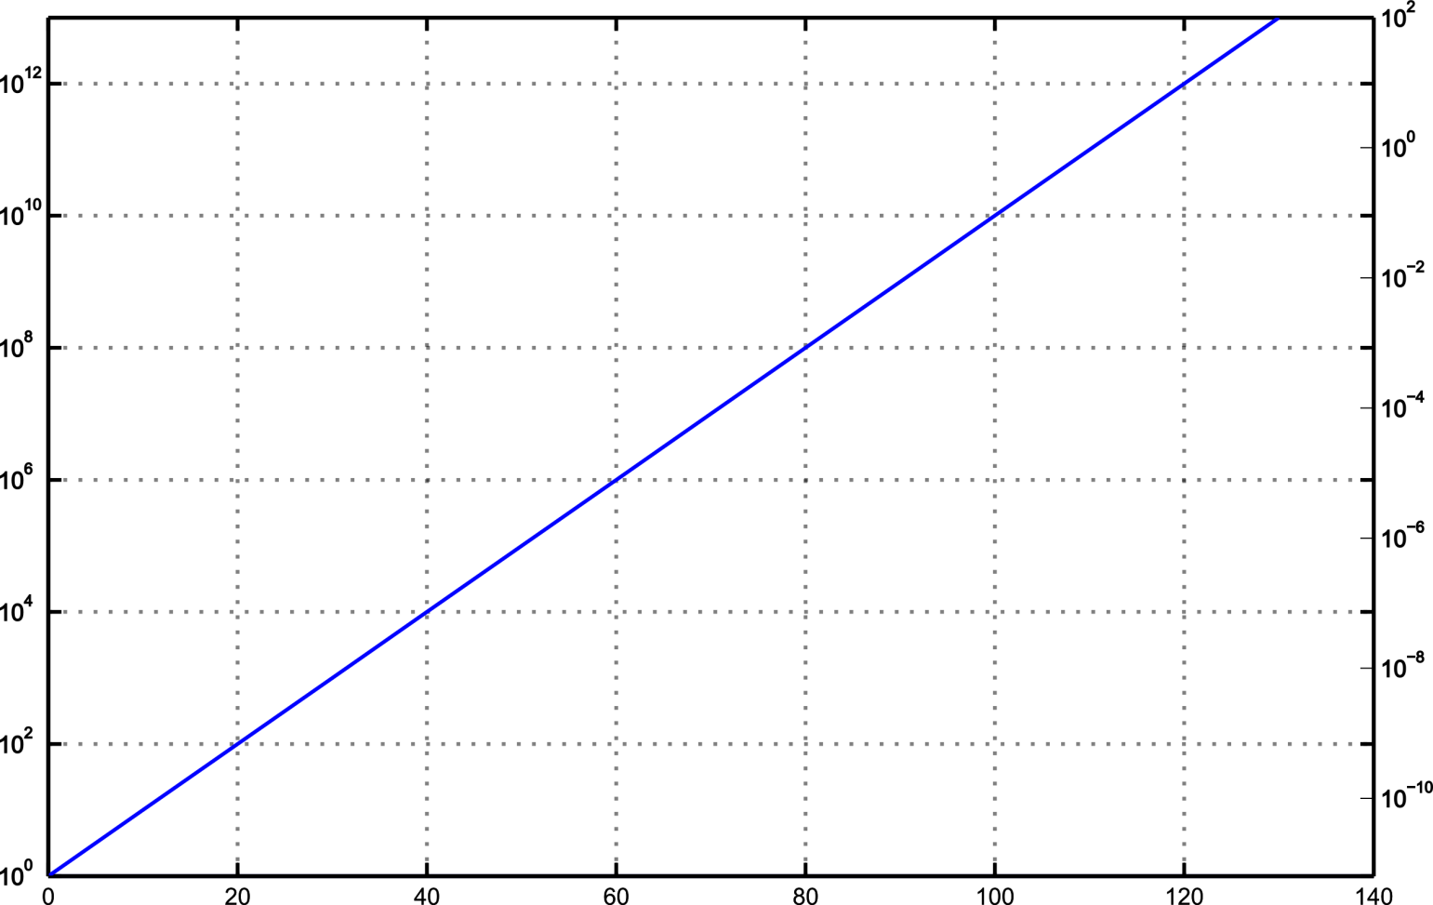
Loss analysis
VATT = 0 dB
VATT = 20 dB
closed connector and VATT = 30 dB
closed connector and VATT = 0 dB
open connector and VATT = 20 dB
Photon number per pulse
open connector and VATT = 0 dB
Corresponding CW power [W]
Complete roundtrip loss [dB]

Slide 19
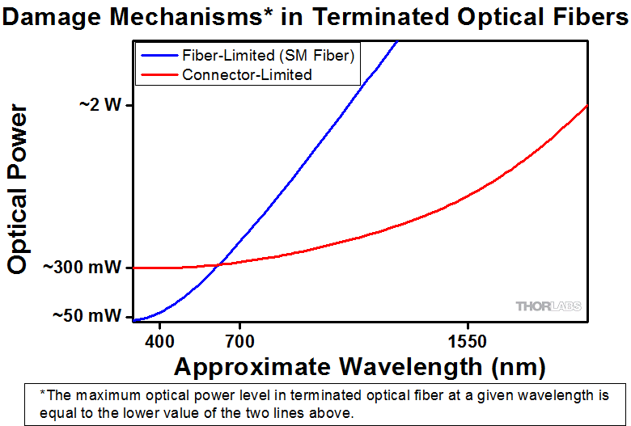
Loss analysis
VATT = 0 dB
VATT = 20 dB
closed connector and VATT = 30 dB
~ 1 W
closed connector and VATT = 0 dB
open connector and VATT = 20 dB
Photon number per pulse
open connector and VATT = 0 dB
Corresponding CW power [W]
Complete roundtrip loss [dB]
http://www.thorlabs.de/newgrouppage9.cfm?objectgroup_id=1792

Slide 20
Loss analysis
VATT = 0 dB
VATT = 20 dB
closed connector and VATT = 30 dB
closed connector and VATT = 0 dB
Eve could use
multiple
back-reflections!
open connector and VATT = 20 dB
Photon number per pulse
open connector and VATT = 0 dB
Corresponding CW power [W]
Complete roundtrip loss [dB]
http://www.thorlabs.de/newgrouppage9.cfm?objectgroup_id=1792

Slide 21
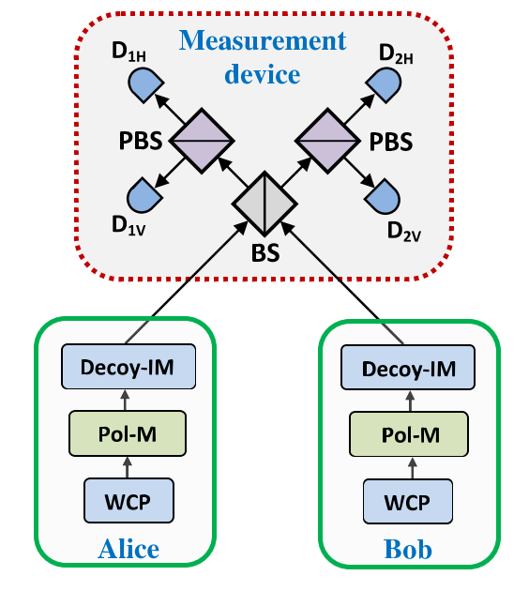
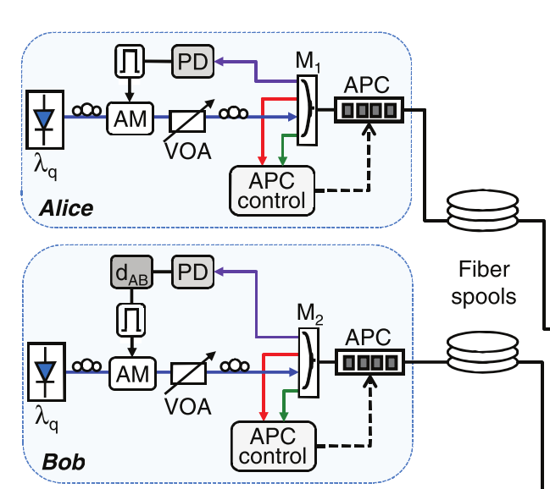
Impact on MDI systems
Original MDI scheme
Proof-of-principle implementation
Alice
(=Bob)
Eve
H. K. Lo, M. Curty and B. Qi, PRL 108, 130503 (2012)
T. Ferreira da Silva et al., PRA 88, 052303 (2013)

Slide 22
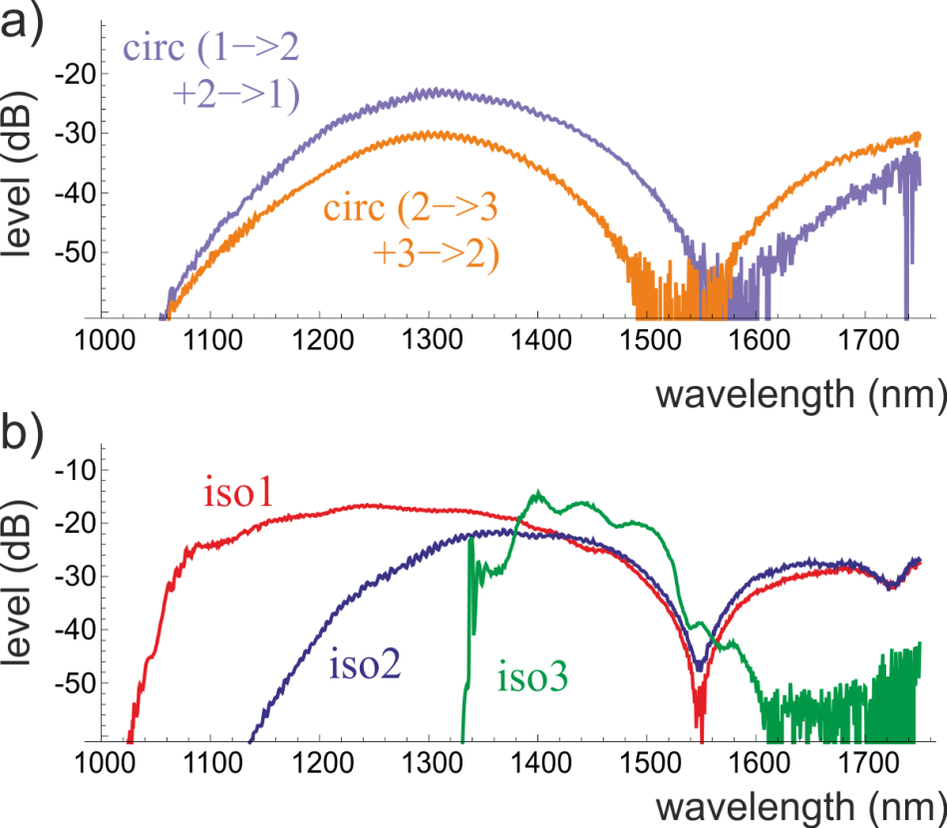
Countermeasures
Transmission spectrum for
double pass through
a) circulator and b) isolator
List of countermeasures
Isolator
Watchdog detector
Wavelength filter
Optical fuse
N. Jain et al., arXiv: 1408.0492, submitted to JSTQE (2014)
S. Sajeed et al., ”Securing two-way quantum communication: the monitoring detector and its flaws”
A. Bugge et al., PRL 112, 070503 (2014)

Slide 23







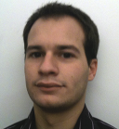


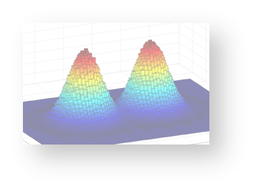
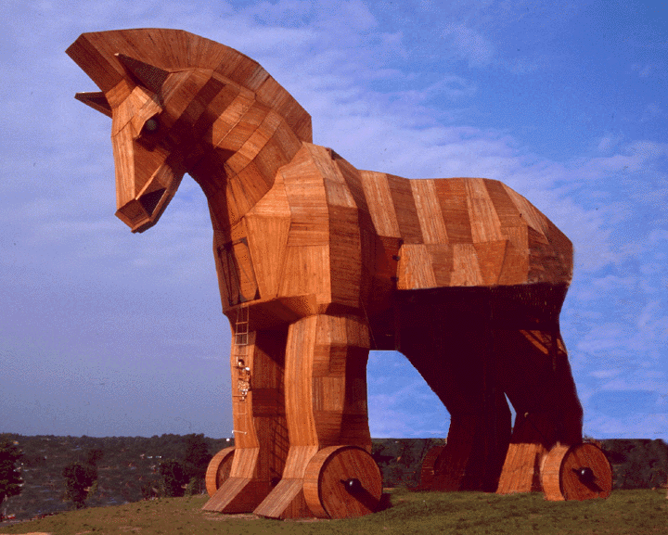


The end
Max-Planck-Institute for the Science of Light, Erlangen
Imran Khan
Nitin Jain
Dr. Birgit Stiller
Dr. Christoph
Marquardt
Prof. Dr. Gerd
Leuchs
SeQureNet and Telecom ParisTech
Alice
Dr. Paul Jouguet
Dr. Sébastien
Kunz-Jacques
Dr. Eleni Diamanti
Thank you for your attention!

